Slide 1
SSP Final Project

Slide 2
Test Data set check (31 person)
Female and Male ratio
Audio Duration?
Train Data
Format
Each person has 10 digits and repeats 50 time
Should concatenate the audio file?
1 digit must be 1
2 digit must be 1 or 0
3 digit must 0,1,2,8,9
2 & 3 digit sequence must be10,12,11,09,08
4 & 5 digit must be 06 or 03, 01 ,20

Slide 3
Simple Statistic of Test Set
Second Number
Third Number
2 & 3 Sequence Number
 | 1 | 0
Count | 25 | 6
Ratio | 80% | 20%
 | 0 | 1 | 2 | 8 | 9
Count | 3 | 3 | 19 | 1 | 5
Ratio | 10% | 10% | 61% | 3% | 16%
 | 10 | 11 | 12 | 08 | 09
Count | 3 | 3 | 19 | 1 | 5
Ratio | 10% | 10% | 61% | 3% | 16%

Slide 4
4 & 5 sequence
1 & 2 & 3 & 4 & 5
 | 01 | 03 | 06 | 20
Count | 1 | 4 | 25 | 1
Ratio | 3% | 13% | 81% | 3%
 | 11006 | 11106 | 11203 | 11206 | 11220 | 10806 | 10901 | 10906
Count | 3 | 3 | 3 | 15 | 1 | 1 | 1 | 4
Ratio | 10% | 10% | 10% | 48% | 3% | 3% | 3% | 13%

Slide 5
6 & 7 sequence
1 & 2 & 3 & 4 & 5 & 6 & 7
 | 15 | others
Count | 12 | 19
Ratio | 39% | 61%
 | 1100615 | 1120615 | Others
C | 3 | 9 | 19
R | 10% | 30% | 61%

Slide 6
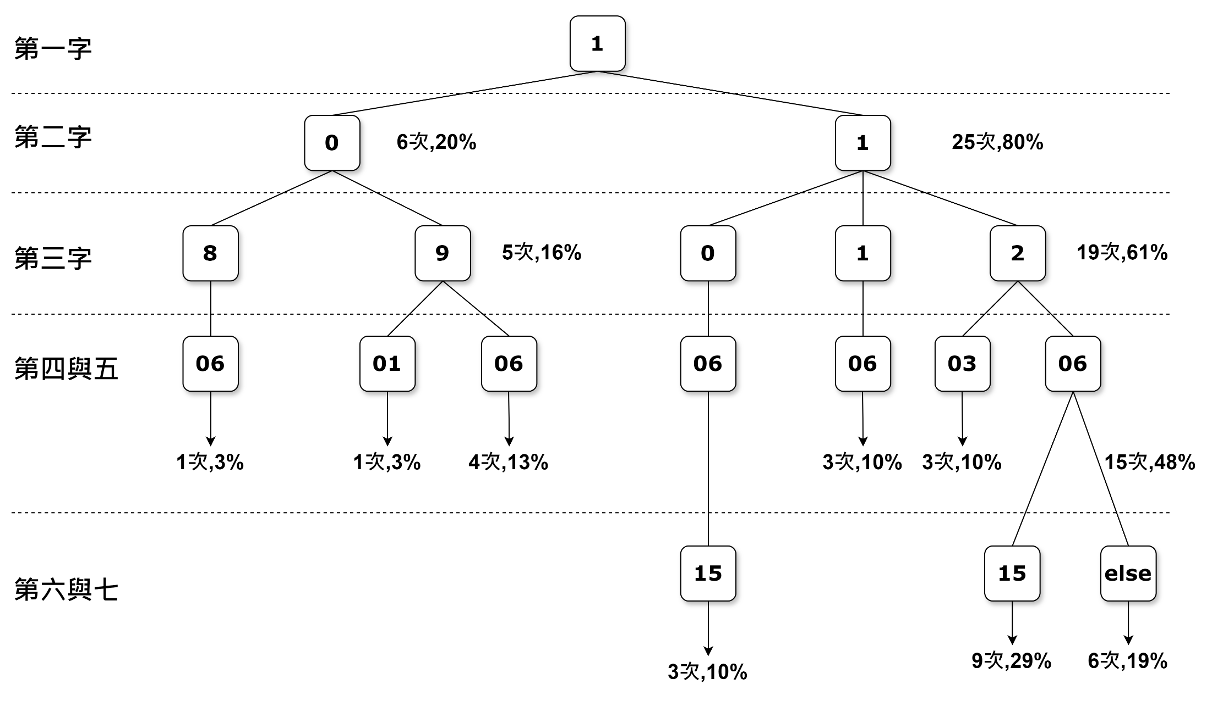
Simple Statistic of Test Set

Slide 7
Digits 出現機率
男女比
女生 8
男生 24
 | total | 0 | 1 | 2 | 3 | 4 | 5 | 6 | 7 | 8 | 9
count | 286 | 44 | 95 | 34 | 17 | 13 | 25 | 34 | 4 | 6 | 14
rate | 100% | 15% | 33% | 12% | 6% | 5% | 9% | 12% | 1% | 2% | 5%

